Slide 1
Managing Risk in
the Small Business
PART 5
Managing Growth in the Small Business

Slide 2
What is Risk?
Risk
  The possibility of suffering harm or loss.
Business Risk
  The possibility of losses associated with the assets and the earnings potential of a firm.
Market Risk
  The uncertainty (gain or loss) associated with an investment decision.
Pure Risk
  The uncertainty associated with a situation where only loss or no loss can occur—there is no potential for gain (only downside).
  Only form of risk that is insurable.

Slide 3
Property Risks
Real Property
  Land and anything physically attached to the land, such as buildings
Personal Property
  Machinery, equipment, furniture, fixtures, stock, and vehicles
Replacement Value of Property
  The cost to replace or replicate property at today’s prices
Actual Cash Value (ACV)
  An insurance term that refers to the depreciated
  value of a property

Slide 4
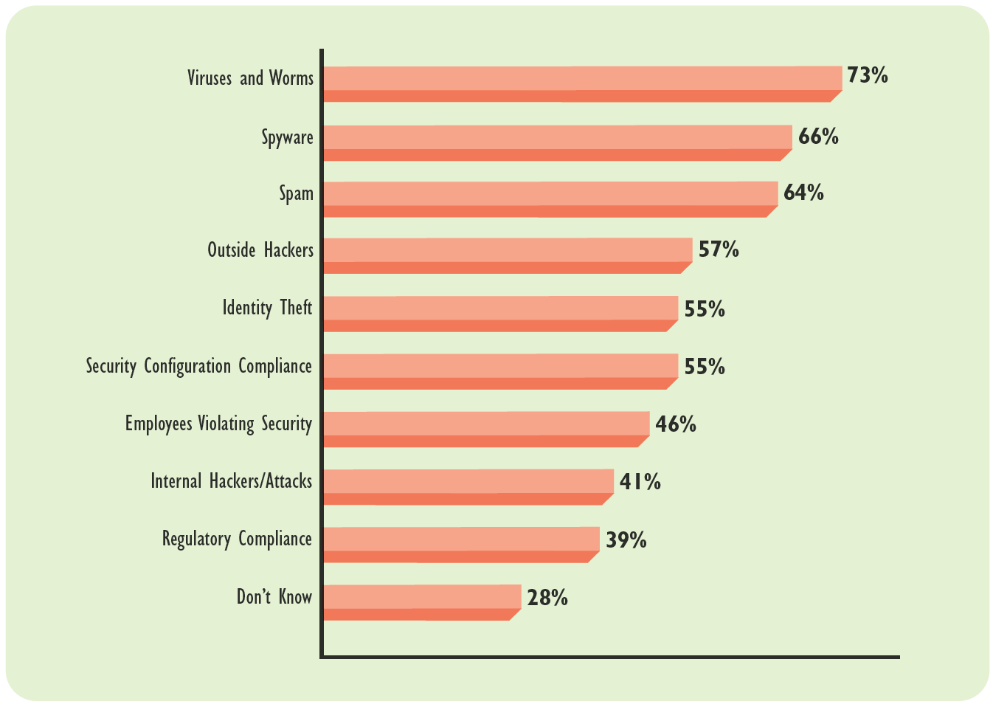
Exhibit 23.1 Security Threats to Computers
Source: Forrester Survey in “What we’re Worrying About,” Inc., March 2007, p. 36.

Slide 5
Property Risks (cont’d)
Peril
  A cause of loss, either through natural events or through the acts of people
Direct Loss
  A loss in which physical damage to property reduces its value to the property owner
Indirect Loss
  A loss arising from inability to carry on normal operations due to a direct loss to property

Slide 6
Liability Risks: Statutory Liability
Workers’ Compensation Legislation
  Laws obligating the employer to pay the employee for an employment-related injury or illness, regardless
  of fault

Slide 7
Liability Risks: Statutory Liability
Workers’ Compensation Legislation
  Laws obligating the employer to pay the employee for an employment-related injury or illness, regardless of fault
Contractual Liability
  Performance or financial obligations (risks) that firms assume when entering into contracts with other parties
Indemnification Clause
  A contractual clause that requires one party to assume the financial consequences of another party’s legal liabilities.

Slide 8
Liability Risks: Contractual Liability
Torts
  Wrongful acts or omissions for which an injured can take legal action against the wrongdoer for monetary damages
Establishing Negligence
  A legal duty between parties to act (or not to act) to cause injury (damage)
  A failure to provide the appropriate standard of care
  The presence of actual injury or damages
  Action that was proximate cause of injury or damage

Slide 9
Liability Risks: Contractual Liability (cont’d)
Reasonable (Prudent Person) Standard
  The typical standard of care, based on what a reasonable or prudent person would have done under similar circumstances.
Compensatory Damages
  Economic or noneconomic damages intended to make the claimant whole, by indemnifying the claimant for any injuries or damage arising from the negligent action

Slide 10
Torts: Types of Damages
Economic Damages
  Compensatory damages related to an economic loss, such as medical expense, loss of income, or the cost of property replacement/restoration
Noneconomic Damages
  Compensatory damages for such losses as pain and suffering, mental anguish, and loss of consortium
Punitive Damages
  Damages intended to punish wrongdoers for gross negligence or a callous disregard for the interests of others and to have a deterrent effect

Slide 11
Product Liability
Manufacturing Defect
  A defect resulting from a problem that occurs during the manufacturing process causing the product to subsequently not be made according to specifications.
Design Defect
  A defect resulting from a dangerous design, even though the product was made according to specifications.
Marketing Defect
  A defect resulting from failure to convey to the user that hazards are associated with a product or to provide adequate instructions on safe product use.

Slide 12
Personnel Risks
Personnel Risks
  Risks that directly affect individual employees, but may have an indirect impact on a business as well.
    Premature death
    Poor health
    Insufficient retirement income

Slide 13
Risk Management
Risk Management
  Ways of coping with risk that are designed to preserve assets and the earning power of a firm.
  Involves finding the best way possible to reduce the cost of dealing with risk.
  Insurance is only one of several approaches to minimizing the pure risks a firm is sure to encounter.

Slide 14

The Process of Risk Management
1
Identify and understand risks.
2
Evaluate risks.
3
Select methods to manage risks.
4
Implement the decision.
5
Review and evaluate.

Slide 15
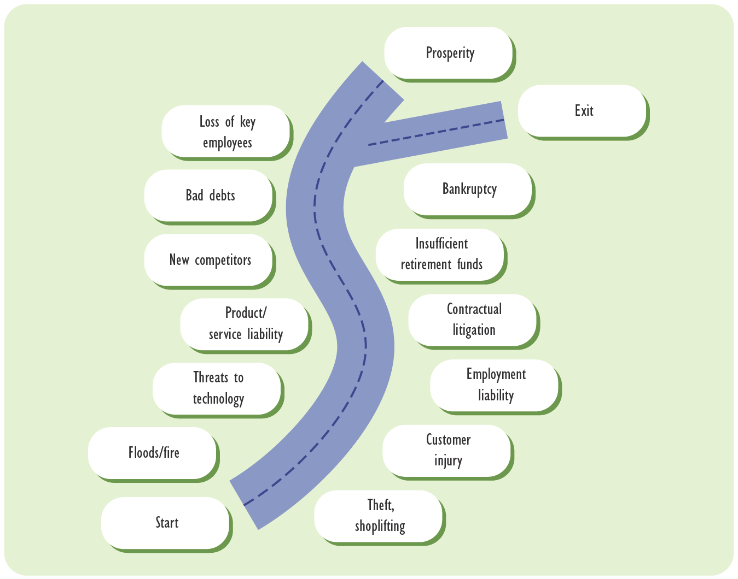
Exhibit 23.3 Risks on the Road to Success

Slide 16
Risk Management and the Small Business
Risk Management Differences from Large Firms:
  Small businesses pay insufficient attention to analyzing potential risk.
  Large firms can assign responsibilities for risk management to a specialized staff manager.
  Risk management is not something that requires immediate attention—until something happens.

Slide 17
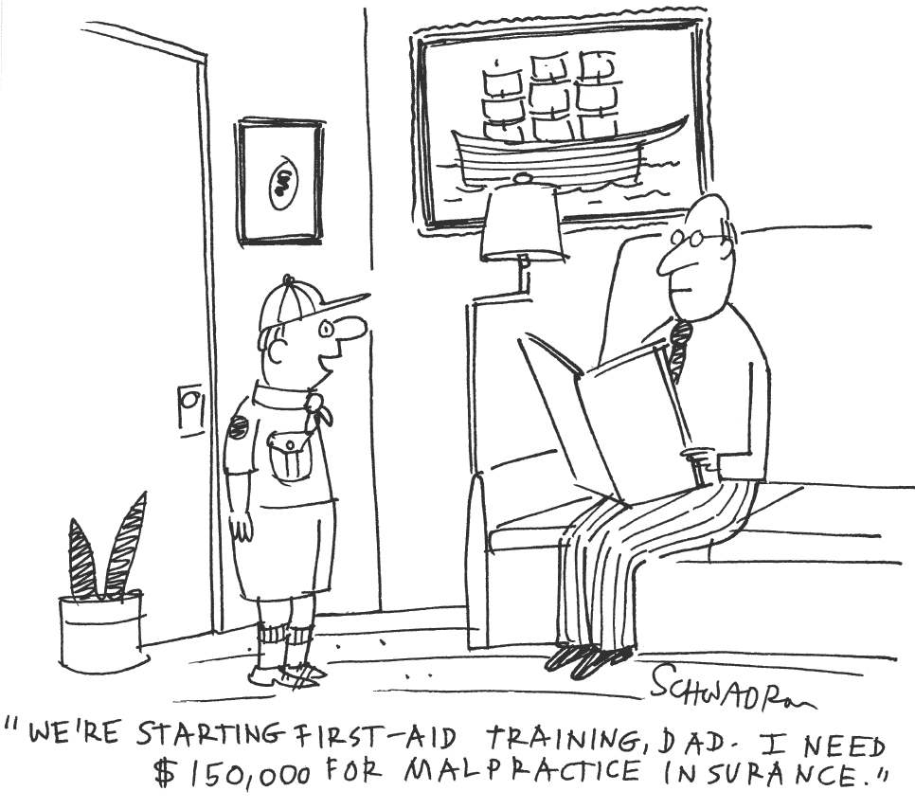
Exhibit 23.2 Risk-Taking Begins Early
© Harley I. Schwadron

Slide 18
Basic Principles of a Sound Insurance Program
Identify business risks that can be insured
Secure coverage for all major potential losses
Evaluating an Insurance Program
Relate premium costs to probability of loss

Slide 19
Requirements for Obtaining Insurance
The risk must be calculable so that premiums can be calculated.
The risk must exist in large enough numbers to allow the law of averages to work.
The insured property must have commercial value.
The policyholder must have an insurable interest in the property or person insured.

Slide 20
Property and Casualty Insurance (cont’d)
Business Interruption Insurance
  Reimburses for lost income plus continuing expenses due to direct loss impacting business revenues.
Commercial General Liability (CGL) coverage
  Covers bodily injury and property damage for which the business is liable.
Automobile Insurance
  Protects against liability and physical damage to a vehicle resulting from insured perils such as collision, theft, vandalism, hail, and flood.

Slide 21
Property and Casualty Insurance (cont’d)
Workers’ Compensation Insurance
  Provides benefits to employees for medical expenses, loss of wages, and rehabilitation expenses, as well as death benefits for employees’ families.
Crime Insurance
  Coverage against employee dishonesty.

Slide 22
Property and Casualty Insurance (cont’d)
Business Owner’s Policy (BOP)
  A business version of a homeowner’s policy, designed to meet the real and personal property and liability insurance needs of small business owners
Advantages of BOP
  A lower premium than would otherwise be required to purchase all coverages separately
  Automatic inclusion of business interruption insurance
  Automatic replacement value protection, as opposed to actual cash value protection

Slide 23
Property and Casualty Insurance (cont’d)
Package Policy
  A policy for small businesses that do not qualify for a BOP that combines property insurance and commercial general liability insurance.
Advantages of Package Policy
  A lower premium than would otherwise be required to purchase all coverages separately
  Ease of adding other coverages more economically
  Inclusion of business interruption insurance
  Inclusion of crime insurance.

Slide 24
Life and Health Insurance
Health Insurance
  Coverage for medical care at hospitals, doctors’ offices, and rehabilitation facilities, that usually includes outpatient services and prescription drugs.
Health Maintenance Organization (HMO)
  A managed-care network that provides health insurance that is generally less expensive than that of a PPO but limits employees’ choices of medical care providers more than a PPO does.
Preferred Provider Organization (PPO)
  A managed-care network that provides health insurance that is generally more expensive than an HMO but offers a broader choice of medical providers

Slide 25
Life and Health Insurance (cont’d)
Key-Person Insurance
  Provides benefits upon the death of a firm’s key personnel.
Disability Insurance
  Provides benefits upon the disability of a firm’s partner or other key employee.
    Disability buyout insurance
    Key-person disability insurance

Slide 26
Key Terms
commercial general liability (CGL) insurance
automobile insurance
crime insurance
business owner’s policy (BOP)
package policy
health insurance
health maintenance organization (HMO)
preferred provider organization (PPO)
key-person insurance
disability insurance

